Slide 1

CASE STUDY ON BIG DATA ANALYTICS
DoorDash
“DELIVERING GOOD”
UNDER THE GUIDANCE OF MRS PRAJAKTA SOMAN
GROUP MEMBERS:- CHIRAG THATHI, PRANAV SARNA, DHRUV VIJAY & TANMAY PANDEY

Slide 2
TABLE OF CONTENTS
INTRODUCTION
PROCESS FLOW
BUSINESS MODEL OF DOORDASH
MOTIVATION
RESTAURANT RECOMMENDATION USING BIG DATA
BIG DATA@DOORDASH
ARCHITECTURE DESIGN
GLOSSARY OF TERMS
LIVE DATASET OF DOORDASH
REFERENCES

Slide 3
INTRODUCTION TO DOORDASH
ABOUT
PROBLEMS IDENTIFIED BY DOORDASH
DOORDASH & THEIR CRITICAL INSIGHT
DoorDash is a technology company that provides on-demand food delivery services. It was founded in 2013 and is headquartered in San Francisco, California. DoorDash connects customers with local restaurants, allowing them to order food for delivery or pickup through its website or mobile app.
Consumers were frustrated by poor delivery times and bad delivery time estimates.
Delivery Person Shortage
Determining accurate delivery times for consumers by taking into account several factors such as traffic , weather and parking conditions.
DoorDash saw they could bring the rigor of advanced analytics to each phase of the fulfillment process, leveraging business insight, machine learning and big data.

Slide 4
Users choose their favourite food by pressing a button that shows up the list of restaurants with a variety of menus listed on DoorDash. Features such as search, nearby restaurants, making choices based on categories, also help the users for better sorting.
Delivery people are assigned to deliveries based on an algorithm that considers factors such as deliver person’s location , availability & prior delivery performance.
The dashers try to make shorten the delivery period as much as is practical. The customers, although not necessarily but usually tip the dashers, the dashers get to keep 100% of the tip received.
CHOOSE ORDER
PAYMENT
DELIVERY PEOPLE
ASSIGNED
TRACKING AN ORDER
DELIVERY
Users make the required transactions after placing their orders online. Once the order has been received by DoorDash, it forwards it to the respective restaurant where it is prepared and packed for delivery.
The delivery person picks up the packed food order from the respective restaurant. DoorDash provides the facility to track the food location so as to have an estimate of the time of delivery.

Slide 5
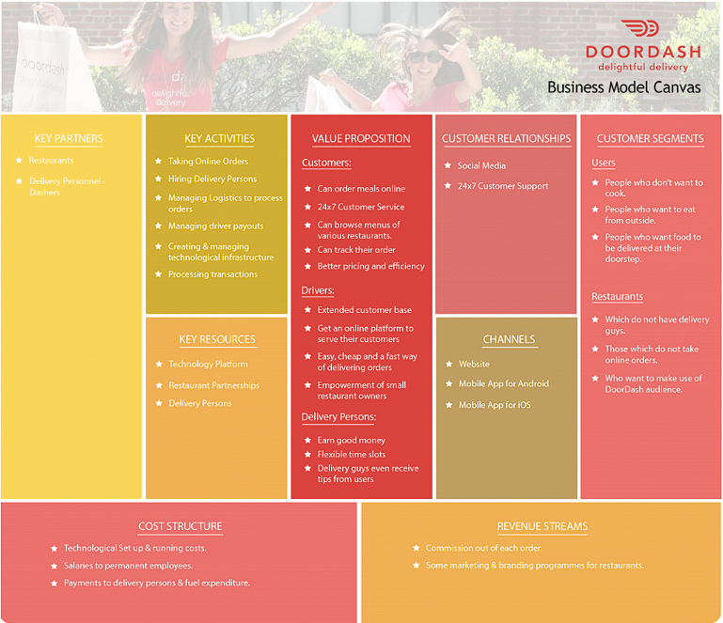
BUSINESS MODEL
DOORDASH

Slide 6
MOTIVATION & SUCCESS STORY
Meeting a need: DoorDash was founded in 2013 in response to the growing demand for food delivery services. The company saw an opportunity to make it easier for people to get their favorite meals delivered to their doorsteps.​
Innovation: DoorDash used technology to create a seamless ordering and delivery experience for customers. Its mobile app and website allow customers to order food from local restaurants with just a few taps.
​
Expansion: DoorDash quickly expanded its operations to cities across the United States, Canada, and Australia, and has become one of the largest food delivery companies in the world.
​
Building a community: DoorDash has built a community of delivery workers, called Dashers, who help bring food to customers. The company has also established partnerships with hundreds of thousands of restaurants, helping them reach new customers and grow their businesses.​
Improving the delivery experience: DoorDash continues to invest in technology and innovations to improve the delivery experience for customers and delivery workers. For example, the company has introduced in-app tipping and real-time earnings tracking for Dashers.

Slide 7
RESTAURANT RECOMMENDATIONS
DoorDash uses big data analytics to recommend restaurants to its user by collecting large amounts of data on user behaviour and preferences. This data is used to build sophisticated algorithms and machine learning models that can Identify patterns and relationships between different variables.
For Example, DoorDash collects data on the types of food and restaurants that users have ordered from in the past, as well as the time of day, location, and other contextual factors that may influence a user's ordering behavior. This data is then used to make recommendations for future orders based on a user's past behavior and preferences.

Slide 8
BIG DATA@DOORDASH
DoorDash also uses big data to analyze restaurant and menu ratings and reviews, as well as data from other sources such as social media, to build a comprehensive understanding of user preferences and behavior. The company's algorithms use this data to identify the most popular dishes and restaurants, and to make recommendations based on the preferences of other users with similar tastes.
Another important aspect of DoorDash's big data strategy is the use of predictive analytics. The company's algorithms use data on customer behavior and preferences to predict what types of restaurants and dishes a user is likely to order in the future. This allows DoorDash to make highly personalized recommendations that are tailored to each individual user's needs and preferences.
Overall, DoorDash’s use of big data is a key factor in the company's ability to provide a highly personalized and convenient food delivery experience for its users. By collecting and analyzing large amounts of data on customer behavior and preferences, DoorDash is able to make more informed and accurate recommendations, which helps to drive customer engagement and loyalty.

Slide 9
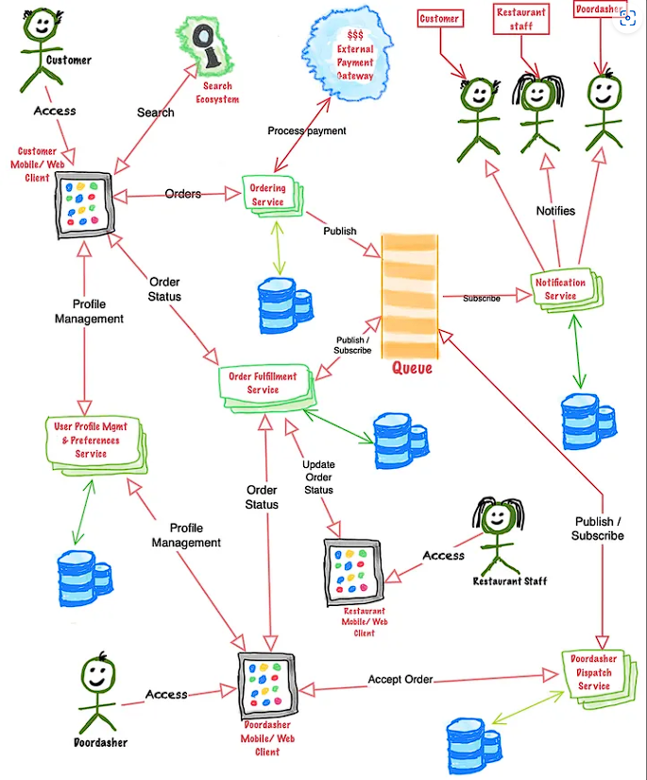
ARCHITECTURE DESIGN OF DOORDASH

Slide 10
ARCHITECTURE DESIGN OF DOORDASH
ORDERING A SERVICE – The service provides menu selection, cart management, and order placement with a payment processing using an external gateway , storing the results in orders database using a relational database. Customers can view full receipts , cancel orders and view their past orders.
ORDER FULFILLMENT SERVICE – The restaurant accepts orders through the app and updates customers on any delays or changes via the notification service. Customers can check order status and doordashers can view order details and receive notifications when it is ready for pickup.
USER PROFILE MANAGEMENT & PREFERENCES SERVICE – The system actors (customers, restaurant staff, doordashers, and admin) create profiles with personal information, role, and preferences. Customers may have preferred restaurants, zip codes, or cuisines; doordashers may prefer specific areas or restaurants, and actors have varying payment and notification preferences. The service manages all actor profiles and preferences.
DOORDASHER DISPATCH SERVICE – Doordashers can view pickup orders from a list, accept them, view past orders, and access customer information for communication and updates.
RESTAURANT PROFILE SERVICE – The service manages restaurant data and allows restaurants to onboard, update their profile, manage menus/dishes, upload images, view financial details, and setup payment methods.
ORDERING A SERVICE – The service provides menu selection, cart management, and order placement with a payment processing using an external gateway , storing the results in orders database using a relational database. Customers can view full receipts , cancel orders and view their past orders.
ORDER FULFILLMENT SERVICE – The restaurant accepts orders through the app and updates customers on any delays or changes via the notification service. Customers can check order status and doordashers can view order details and receive notifications when it is ready for pickup.
USER PROFILE MANAGEMENT & PREFERENCES SERVICE – The system actors (customers, restaurant staff, doordashers, and admin) create profiles with personal information, role, and preferences. Customers may have preferred restaurants, zip codes, or cuisines; doordashers may prefer specific areas or restaurants, and actors have varying payment and notification preferences. The service manages all actor profiles and preferences.
DOORDASHER DISPATCH SERVICE – Doordashers can view pickup orders from a list, accept them, view past orders, and access customer information for communication and updates.

Slide 11
EXTERNAL PAYMENT GATEWAY – This component can interface with popular payment gateways like Amazon Payments, We Pay, PayPal, Apple Pay, or individual Credit Card providers like Amex, Visa, Mastercard, etc. The Order Service will interact with this component to ensure the payment is done at the time of confirming the order. The interaction should be synchronous in nature.
NOTIFICATION SERVICE – The notification service delivers notifications to actors in their preferred method (push, text, email, in-app) and abstracts the underlying communication with mobile carriers and email providers. It informs customers about various stages of the order, restaurants about order updates, and doordashers about orders waiting for acceptance, readiness for pickup, or delays.

Slide 12
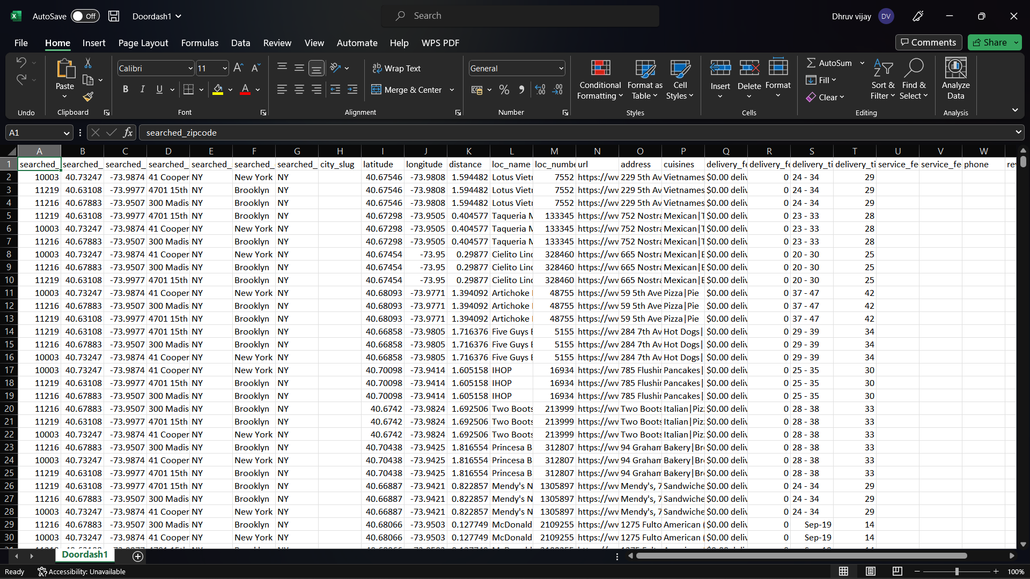
DOORDASH DATASET - .CSV FILE

Slide 13
Data@doordash
DoorDash collects data from various sources, including customer and merchant feedback, app usage data, delivery and order information, and payment data.
DoorDash operates in over 4,000 cities in the United States, Canada, and Australia.DoorDash has partnerships with over 450,000 merchants.
DoorDash offers several delivery options, including standard delivery, group orders, and catering.
DoorDash uses machine learning and AI to optimize delivery times, predict demand, and improve courier efficiency.
DoorDash's data includes information on restaurant performance, such as order volume, order accuracy, and customer satisfaction.
DoorDash collects payment data, including payment methods and transaction histories.
DoorDash's data infrastructure includes technologies like Apache Kafka, Apache Spark, and Apache Hadoop.
DoorDash processes billions of data events per day and has generated several petabytes of data.
DoorDash's data team includes data scientists, analysts, and engineers with diverse backgrounds and expertise.

